Slide 1






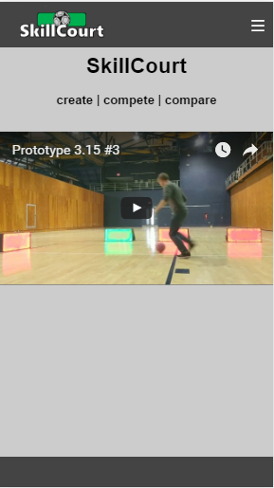
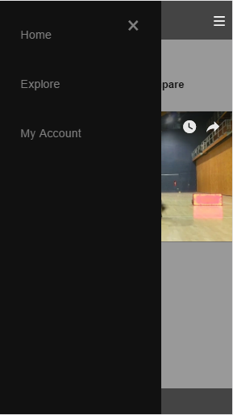
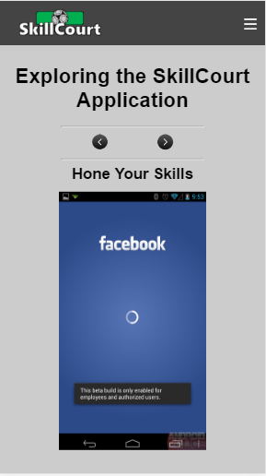
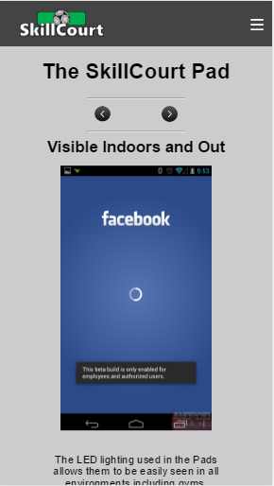

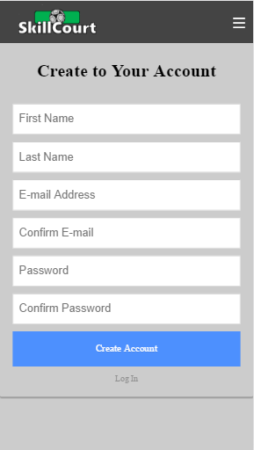

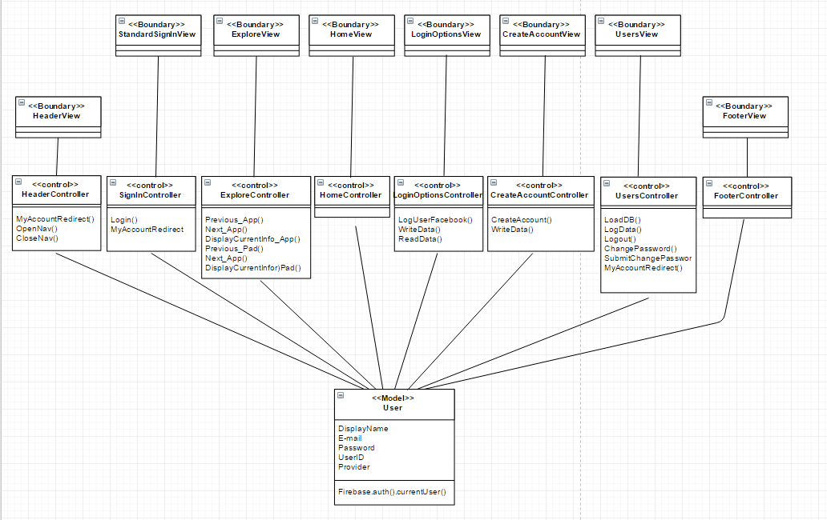


School of Computing & Information Sciences
Senior Project, 2017, Spring
SkillCourt Website
Student: Antonio Riverol, Florida International University
Mentor: Guðmundur Traustason, SkillCourt CEO
Instructor: Masoud Sadjadi, Florida International University
Problem
SkillCourt has no functioning website
Interested individuals should have a way to
Learn about SkillCourt
Sign up for a SkillCourt account
Solution
A new SkillCourt website will have to be built from scratch
The new website should use the already available AWS account, domain, and Firebase database
Up-to-date technologies should be used to promote future alterations and additions
Current System
SkillCourt lacked a website
www.skillcourt.com would link to a blank web page
Screenshots
(displayed on mobile device for spacing purposes)
Requirements
The website must run on an AWS server
The website must display on www.skillcourt.com
The website must use the already populated Firebase database
The website must adapt to display size
The website must allow Facebook login
The website must allow e-mail login
The website must provide information about SkillCourt
System Design
Implementation
Deployed with Amazon Web Services
Web routes using ExpressJS
Web requests handled by NodeJS
Web content with HTML
Web styling with CSS
Web logic with Javascript
Facebook login with Facebook for Developers
Database by Firebase
The data is contained in Firebase and can be manipulated by the controllers
A separate view is created for each web page, header, and footer
Each view has a controller with its own set of functions
Verification
HTTP requests and tests performed with Postman
Login verification performed by Firebase and Facebook for Developers
Object Design
Summary
The current system was non-existent
The new system had to be built from scratch with modern technologies and practices
The new SkillCourt website is now up and running
Acknowledgement
I am thankful to my group members Chandan Aubel and Alvaro Silva, and to our product owner Guðmundur for constant feedback and advice.
Notes:
‹#›

